Slide 1
Teradata Basics
Lesson 04: Teradata Utilities Fast Export

Slide 2
Introduction about Teradata Utility
What is the need of Teradata utilities in Data ware house:
Quick access to data for more timely decision making.
Solutions for the entire spectrum of load requirements from batch to real time.
Unmatched scalability for large volume loads.
Fail-proof loads with checkpoint restart capabilities.
Proven technology from the data warehouse technology leader.
Integration with industry-leading ETL and ELT tools.

Slide 3
Introduction about Teradata Utility
Teradata Utilities:
BTEQ: Help for Report formatting, Ad hoc query tool, Database administration, Best for small data volumes
Fast Export :High-performance data unload in client format.
Fast Load: High-performance initial table load.
Multi Load: High-performance maintenance operations multiple tables in single pass.
Apart from this Teradata having other utilities like Teradata Parallel Transporter, Tpumps etc.

Slide 4
Module Object
Fast Export Definition
Supporting Environment
Execution Process
Start with .BEGIN EXPORT and .END EXPORT
Set the output file with .EXPORT
Fast Export Support and Task Commands
Some key features of Fast Export

Slide 5
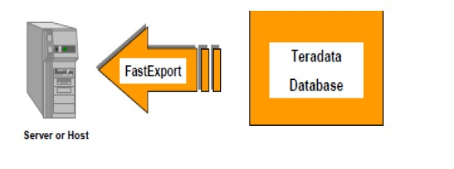
Fast Export Definition
Fast export known for its lighting speed , it comes to exporting large volumes of formatted data from Teradata to host a file either mainframe or network attached system.
Features---
It support multiple sessions.
It support multiple tables.
It support the restartibilty.
Recommendation:
Fast export is the best choice if the volume of data more than half a million records.

Slide 6
Supporting Environment
The Fast Export utility is supported either on either the mainframe or on network attached system(LAN).
The LAN environment supports the following operating systems:
UNIX MP-RAS
Windows 2000
Windows 95
Windows NT
UNIX HP-UX
AIX
Solaris SPARC
Solaris Intel

Slide 7
Supporting Environment
The Mainframe (Channel Attached) environment supports the following
Operating Systems:
MVS
VM
CAUTION: The Teradata RDBMS will only support a maximum of 15 simultaneous FastLoad, MultiLoad, or FastExport utility jobs

Slide 8
Execution Process
Logon to Teradata for the utility Fast Export.
.BEGIN EXPORT
Create utility logs into Teradata database.
Retrieves records from Teradata Database and put them in to spool.
Pass the records from SPOOL to work tables.
Blocks are created and distributed into AMP.
.END EXPORT
Logoff Teradata Database

Slide 9




Start with .BEGIN EXPORT and .END EXPORT
.BIEGIN EXPORT
.BEGIN EXPORT TENACITY
SLEEP
SPOOLMODE
NOTIFY
rsESSIONS max [min]
hours
minutes
SPOOL I NOSPOOL NOSPOOLONLY
OFF LOW I MEDIUM HIGH ...,];
SESSIONS
•,
Maximum.. and optionally, minimum
Fast Export.
number of sessions the utility may use - defaults to 4 for UNIX
•,
The utm1ty wiH log on two additionalll SQ[Lsessions: one for the Restart· Log and one for the SEl.ECT.
TENACITY
•,
SLEEP
•,
Number of hours FastExport wi1II try to establish a connection to the system; default is 4.
Number of minutes that FastExport willl wait between lllogon attempts, default is 6.
NOTIFY
•
•
Parameter for specifying the notify user exit option
The f'astExpo1rt manualll spedfi1es i1n detai1lll whkh events are associated with each lllevelll .
I
. END EXPORT;
•,
•,
Delirnlts a series of commands that define a single EXPORT action.
Causes the utilitv to send the SIE .E1CT(s) to the Teradata Database.

Slide 10

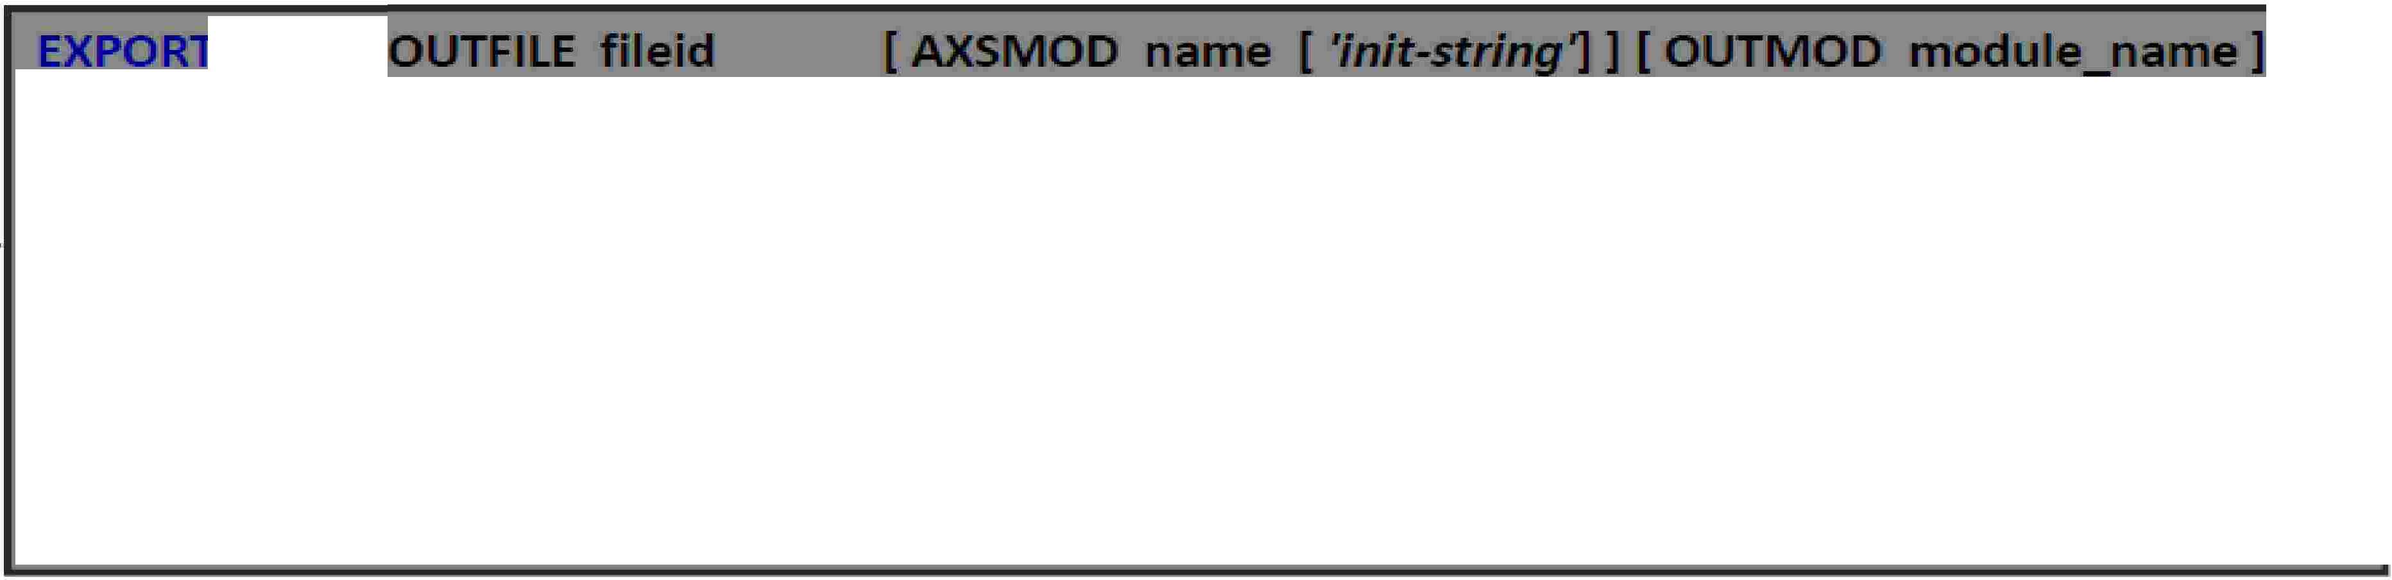

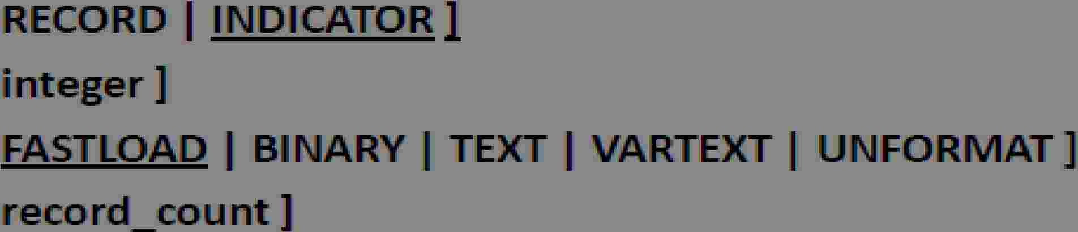









Start with .BEGIN EXPORT .END EXPORT
MODE
If RECORD, then i'1ndlicat¹or lbyt¹es, fo1r r·. ULLs, a1re 1not mcluded ln exported da1ta1.,
If INDICATOR, then ind-ca1tor bytes 'for NU Ls are i'1ncl1uded ln exipo1rted data,
BLOCKSIZE
Defines, the, 1m1ax1imiu1m1 block size to be used in1 1retulining exported data., Def.au It (and
max:i'mum) i's, 63.,5 KB.,
FORMAT
Record format ¹of the export fil¹e, on netw·o1rk-attached UNIX and Windows, IP a1tforms,.
OUTLIMIT
Defines, the, 1m1axiimiu1m1 number of records to lbe Wli-tten to , he output host fi' e,
MLSCRIPT
Fast xport gene:ra1tes a 11 JUI ,_Load scrlpt that can be used ater to load the exported data back into, a Teradata syst¹e:m1.,

Slide 11









A Fast Export Script
Define log table for Restartibilty
Connect to database
loetable U_QUAL2.tllo1,
. aeon 10.67 .180.194/U_QUAL2,U_QUAL2,
Specify the number of Sessions
.becin export sessions 4;
.export outfile fex_out.txt mode record format text;
se ect
course_·d (char(l)),
course_name (VARC
cred" (char(S)), seats (char(5))
from course_tab e 1;
Destination File
AR(20)),
SQL
.end export;
Send Request
• oeoff;

Slide 12













A Fast Export Script
I
I -----t
Define Restart Log1
.LOGTAB,LE
.RU
.SET
.SET
.BE¹GIN
.EXPORT
Restartlogl_fxp;:
FIILE logon;
CityName TO 'Los Angeles,�;
Zip¹Code TO 90666,;
EXPORT SESSIONS 4;
OUTFll llE custacct_data;
I
]
;
-----t
__,,,,,,,
Spedfy number of sessions
Destination file
Via a SELECT,. speclfv the
SELECT
A.Account: INu m ber
, C.Last Name
, C.F'irst:_Name
, A... Balance_Curre t
Aecounts A
Aocounrts. Customer AC
Custo mer C
collumns and
rows to export.
FROM
INNEIRJOIN
ININlEIR JOINI
ON
ON
WHERIE
A D
ORDER BY
.END EXPORT;
C.Cus,tomer Number= A.C...Customer Number
A.Account: Number= AC..Ac¹count umber
A.¹City·
= ·&cityName··
A ..Zip_Code = ,&ZipCode
1"_{J}'
Send
request.
I
----+
I
.LOGOFF;
I
Terminate sessions
11----+--------------------------------

Slide 13
Multiple Export in one fast Export
.logtable U_QUAL2.t11og;
.logon 10 67.180.194/U_QUAU,U_QUAU•
• DISPLAY 'Exporting fex_out1.txt-&SYSOATE4 TO F LE D:\Sandeep\a.txt•
• export outfile fex_out1.txt mode record format text;
select
course_id (char{t)),
course_name (VAROIAR(20)), aedit (char{3)),.
seats (char(S))
from course_table1;
.DISPLAY 'Exporting fex_out2.txt-&SYSOATE4 TO F LE D:\Sandeep\a.txt•
• export outfile fex_out2.txt mode record format text;
select
course_id (char{t)),
course_name (VAROIAR(20)), aedit (char{3)),.
seats (char(S))
from course_table2;
logof

Slide 14
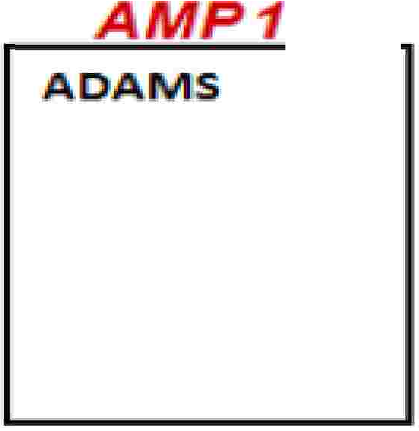



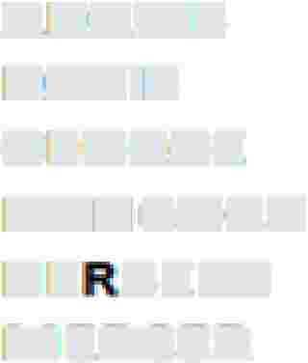













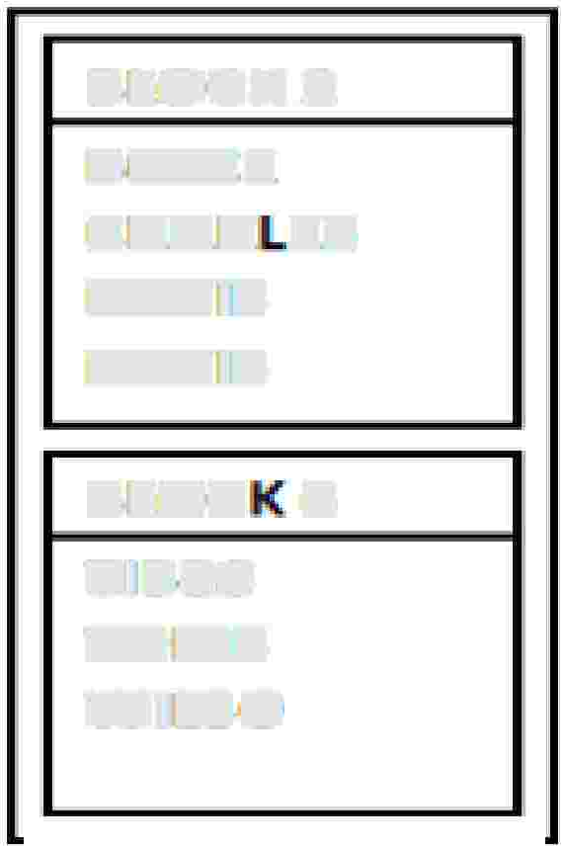
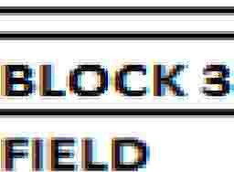

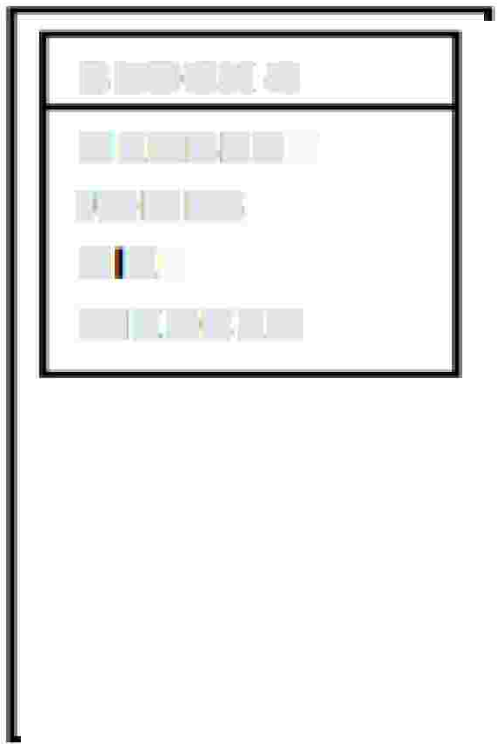


The SORT Procedure
Re·spons.¹e 11"0¹ws _ocal_y
son,ed i-- S1P00¹L:
A
P.2'
A
B¹0YCE
CHARLES
' ERBE ·T
P¹0TTE.R
A
P'4
BATES
DAVIS
Kl El
- ICHOLS
PETERS
TilBBS
TOMS
ADAIMS
B,OYCE
1
DAVIS
GEORGE
HANl1COCK
HE-B,ERT
MERiC!ER
FIE
_{D}1
JONES.
SMIT
WIIILS.ON
Venical
ID¹"'st
- utton:
ADAMiS
ADAMS
DAVIS
DA:Vlrs
HEAB:rE:R:T
HE BE :T
ICHOLS
TIJB,BS
BATES
BOYCE
BOYCE
GIE.OR·GE
CHARLJES
FIELD
HA.r COCK:
J01 ES
PETERS
TOMS
I EIL
Ml
CER
SMITH
BLOC.K 2
a,ovce
1CHAR ES
DAVIS
DAVIS
B,ILJOiCK 4
HER.B¹ERT
JONES,
KIEL
MIERCER
B, -TES
BOYCE
GEOREi'E
HA ·coc
-ERBERT
BLOC 6
TilBBS
TOMS
WILSO
POTTER.
S
ITH

Slide 15

Important Commands and meaning
Task Commands
BEGIN EXPORT
Begins the export task and sets the specifications for the number of sessions with
Teradata.
Ends the export task and initiates processing by Teradata.
Provides. two things. which are.. The client destination and file format specifications
for the export data retrieved from Teradata, A. generated Multi Load script file that
can be used later to reload the export data back into Teradata
Constitutes a field in the input record section that provides data values for the
END EXPORT
EXPORT
FIE D
SE LE CT state me
t.
FIILLER
Specifies a field in the input record that uvill not be sent to Teradata for processing.
It is part of the input record to provide data values for the SELECT statement.
IMPORT
Defines the file that provides the USING data values for the SELECT.
LAYOUT
Specifies the data layout for a file. It oonta ins a sequence o
FIELD and FILLER
commands. This is used to describe the import file that can optionally provide data
values for the SELECT.

Slide 16
Key features of Fast Export
Fast Export EXPORTS data from Teradata.
Fast Export does not import data into Teradata , like BTEQ it can output
multiple files in a single run.
Fast Export only supports the SELECT statement.
The only DML statement that Fast Export understands is SELECT.
Choose Fast Export over BTEQ when Exporting Data of more than half a million+
It is recommended use Fast export , if you have huge volume of data for exporting.

Slide 17
Key features of Fast Export
Fast Export supports multiple SELECT statements and multiple tables in a single run.
Fast Export supports multiple select and each select can use 64 tables.
Fast Export supports conditional logic, conditional expressions, arithmetic calculations,
data conversions.
Fast Export does NOT support error files or error limits.

Slide 18







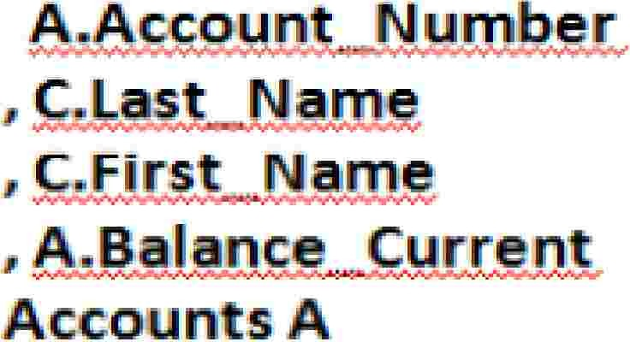



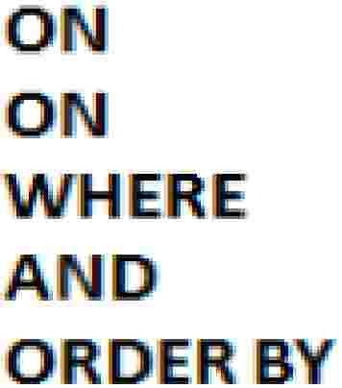
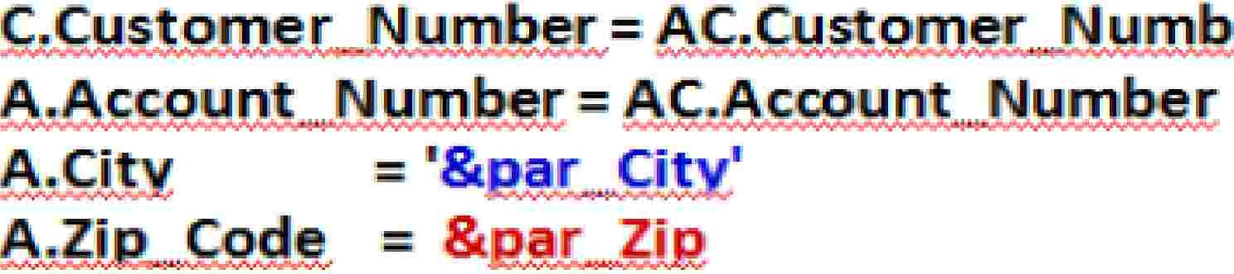






A FastExport Script with ACCEPT
'Los Angeles' 90066
.L.OGTAB
.RU .
E
[par_City par_Zip
ACCEPT variables from input
record.
)
.ACCEPT
IL
. parmrr
e
;
.BEGI
EXIPOR.T SESS D' 54.;
.EXPO;
SELECT
FRO.
I
I
I.
·.
ER JOI I
E · JIOINI
.Acoo nts 1Custo
Custo,merC
c.c s- .·
eri· AC
er
Reference accepted
variables with an&.
.1;
.END EXPORT.;

Slide 19
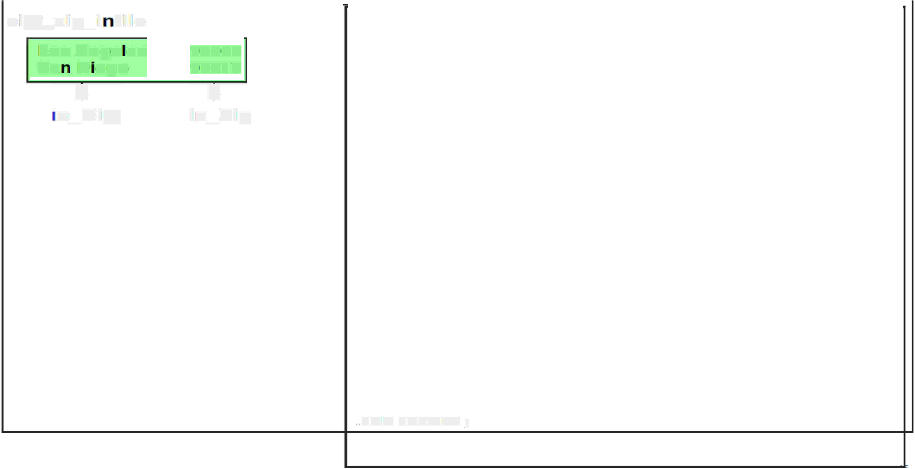


















A FastExport Script with LAYOUT
ciity�zip_ii fiil,e·
Los Ange es
,.LOGTABlE
Res.t:a rt Log1 _fx p;
90066
90217
J,
in._Zip
,.RUN
,.. BEGIIN
IFILE logon ;:
EXPORT SESSIIDNS 4;
Sa
D
J.-
ego
.. LAYOUT
..HELD
..HELD
Record_Layout ;
in_City·
in_Zip
· n._City
1 CHAR(2D);
* CHAR(S);
IIMPORT fields input records.
from
)
.. IMPORT
I NFILE city_zi p_'infile LAYOUT Re,cord_Layout ;
.. EXPORT
SELECT
OUTFIILIE cust_,acct,_outfile2;
A.. Account_Number
,. rC.ILast_Name
, rC.IFir.st_Name
, A .. Bal,a n c,e_Current:
Accounts A
Acoount's_Customer AC
CustomerC
FROM
INNER .JOIN
INNER .JOIN
ON
ON
'WHIERE
A.ND
OIRDER BY
C..Customer _Number= A¹C .. iOustnmer_Number
A.Acco,unt_Number = AC .. Account_Number
Reference imported
fields wi'lh a :
)
A.City
A.Zip_Code
^{1"}I'
= :in_City
= :in_Zip
,.END EXPORT;
.. LOGDFF;

Slide 20
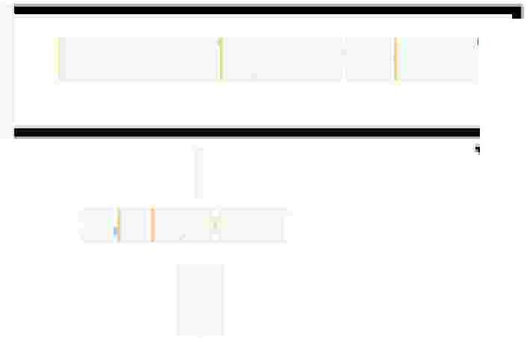




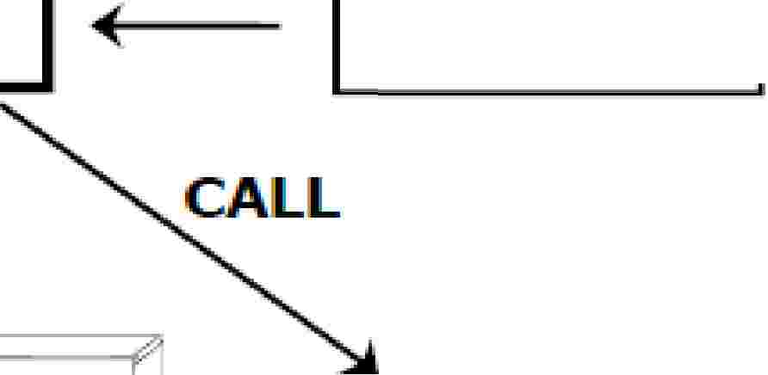

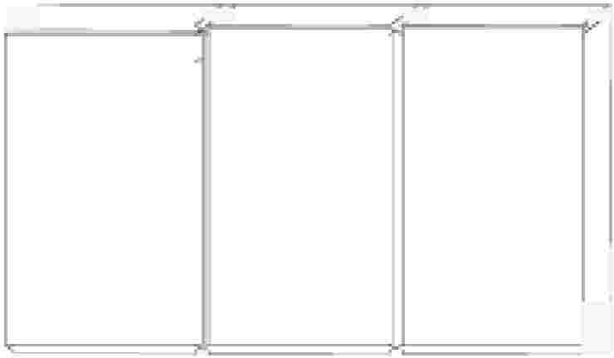




INMODs and OUTMODs
I
CALL
READ
FASTEXPORT
I
SELECT
i
INIMOD
INPUT
DA A
/
,-7
o:
h'
I
'WRITE
�
II OUTMOD
OUTPUT'
DATA
I
[)
--
INMODs
•
•
•
Read input data
values from a file.
Qua I i1fy SELECT requests.
Usually more app icable to an import utility such as Mult:iload.
OU TM ODs
•
•
•
Process. an swer-s¹et: data.
Modify, di.sea rd, or re cord responses...
Usually more app icable to an export utllltv such as FastExport.

Slide 21
Application Utility Checklist
Feature
BTEQ
Fastl.oad
Fastfixport
Mulltil.o,ad
TP'Ulmp
IDOL Functions
ALL
LIIMITED
INo
DML Functions
ALL
I INSERT
SELECT
IMultip,le DML
Yes.
Yes.
Yes.
SQIL
INo
Yes
Yes
Yes
EXPORT
IMultip,le Tables
INo
IMu ltiple Sessions
Yes
IfAST LOAD
Proto co Used
Cond ltlonal Exp ress ions
Yes.
Yes.
Yes.
INo
INo
Yes
Yes
Yes
INo
Arithmetic Ca I cu I at ions
INo
Data Conversion
1 per column
Error
[files
Yes
Yes
Yes
Error ILi mits
INo
INo
User-written
Routines
No
Yes

Slide 22
QUIZ
1.Which two statements are true about data integration utilities? (Choose two.)
A. BTEQ is limited to using one session.
B. FastExport is used to export large amounts of data.
C. BTEQ allows import/export across all supported platforms.
D. SQL Assistant supports report writing and formatting features.
what is destination file
A).export outfile custacct_data
B).logtable restartLog1_fxp
C) on A.Account_number=AC.customer

Slide 23
QUIZ
3.which utility uses select feature
A)FastExport
B)Fastload
C)Bteq
D)Tpump

Slide 24
Summary
Best choice for exporting large amounts of data from the Teradata database to a host file using multiple sessions.
Fully automatic restart capability.
Specialized processing of output data can be handled using an OUTMOD routine.
Teradata accommodates not more than 15 ‘LOAD’ applications at any one time (FastLoad,MultiLoad, FastExport).

Slide 25
Lab Exercises
Lab Exercise 5-1 - Purpose
In this lab, you will use FastExport to create an export file that contains one record for each transaction. You will have to join columns from two different tables in order to create the export file.
What you need
Populated TD_BIM_FR_TRNG_DB.Accounts and TD_BIM_FR_TRNG_DB.Trans tables.

Slide 26
Lab Exercises
Tasks
1. Create a FastExport script that outputs to file data5_1. For each transaction in the
AU.Trans
table, include the transaction_number, account_number, number, street, city, state and zip of the
associated account (AU.Accounts).
2. Run the script.
3. Test the result by opening the data file..

